Slide 1

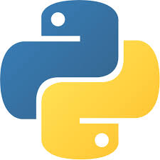
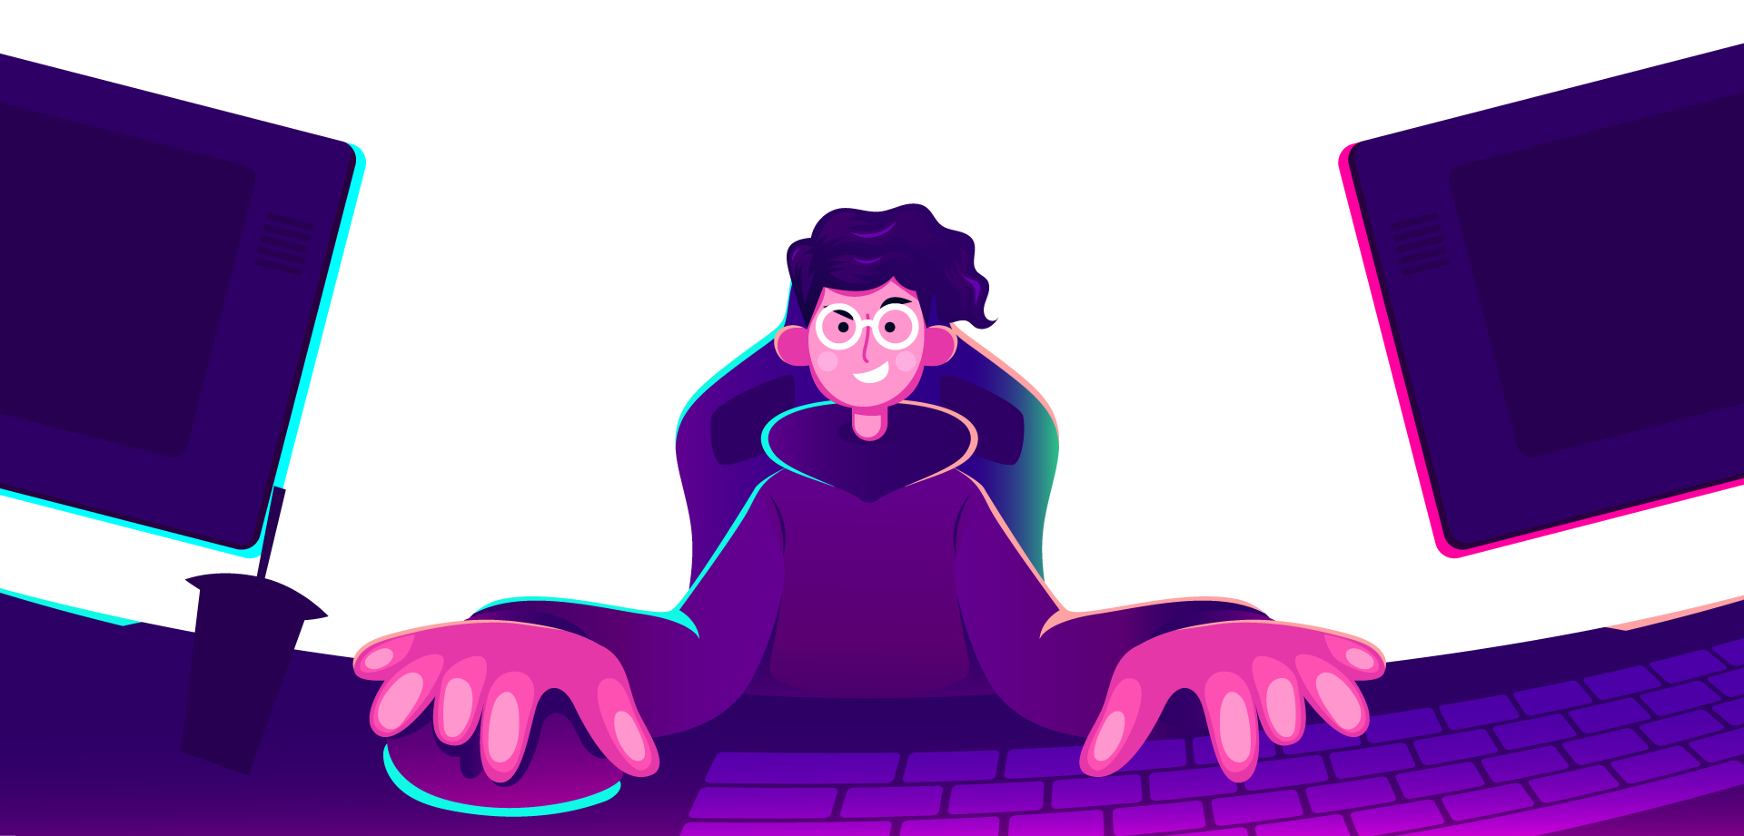
AI Master Class series – Day 16
Optical Character Recognition

Slide 2
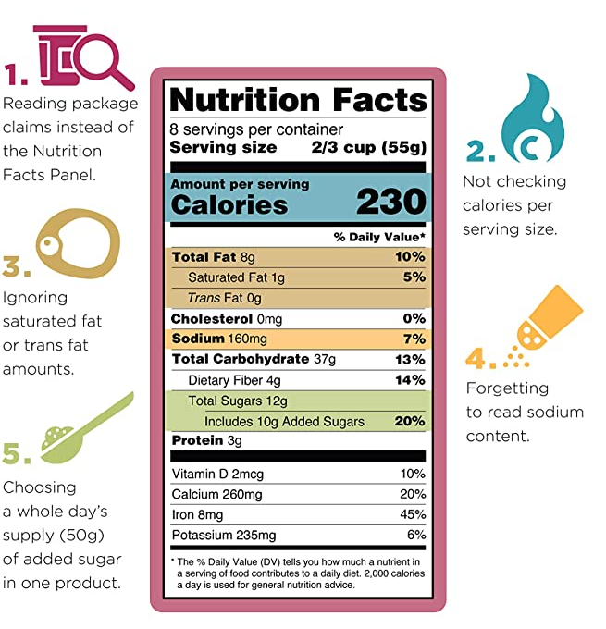
Label Reading.
Label-reading skills are intended to make it easier for you to use the Nutrition Facts labels to make quick, informed food decisions to help you choose a healthy diet. Overview | Serving Information | Calories | Nutrients | The Percent Daily Value (%DV) | Nutrition Facts Label Variations.

Slide 3
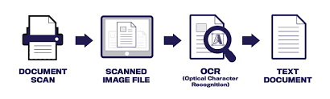
Optical Character Recognition.
Optical character recognition or optical character reader is the electronic or mechanical conversion of images of typed, handwritten or printed text into machine-encoded text, whether from a scanned document, a photo of a document, a scene-photo or from subtitle text superimposed on an image.
The first step of OCR is using a scanner to process the physical form of a document.
Once all pages are copied, OCR software converts the document into a two-color, or black and white, version
The scanned-in image or bitmap is analyzed for light and dark areas, where the dark areas are identified as characters that need to be recognized and light areas are identified as background
Pattern Recognition & Feature Detection

Slide 4
Methodology of deploying Label reading.
Google Vision, Amazon Rekognition
PAID
01
PyTesseract
FREE
02
Custom Training from Scratch with ROI
01
www.pantechsolutions.net

Slide 5

! PRACTICAL SESSION !
Label Reading

Slide 6
Installing Libraries
Tesseract-OCR Executable: https://www.pantechsolutions.net/media/attachment/file/t/e/tesseract-ocr-w64-setup-v5.0.0-alpha.20200328.exe

Slide 7
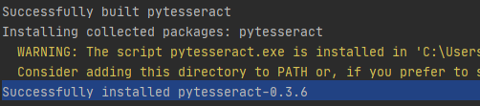
Installing Libraries
Pytesseract: pip install pytesseract

Slide 8
Extracting Text from Image - Pytesseract

Slide 9
try:
from PIL import Image
except ImportError:
import Image
import pytesseract
pytesseract.pytesseract.tesseract_cmd = r'C:\Program Files\Tesseract-OCR\tesseract.exe'
def recText(filename):
text = pytesseract.image_to_string(Image.open(filename))
return text
info = recText('test.png')
print(info)
file = open("result.txt","w")
file.write(info)
file.close()
print("Written Successful")

Slide 10
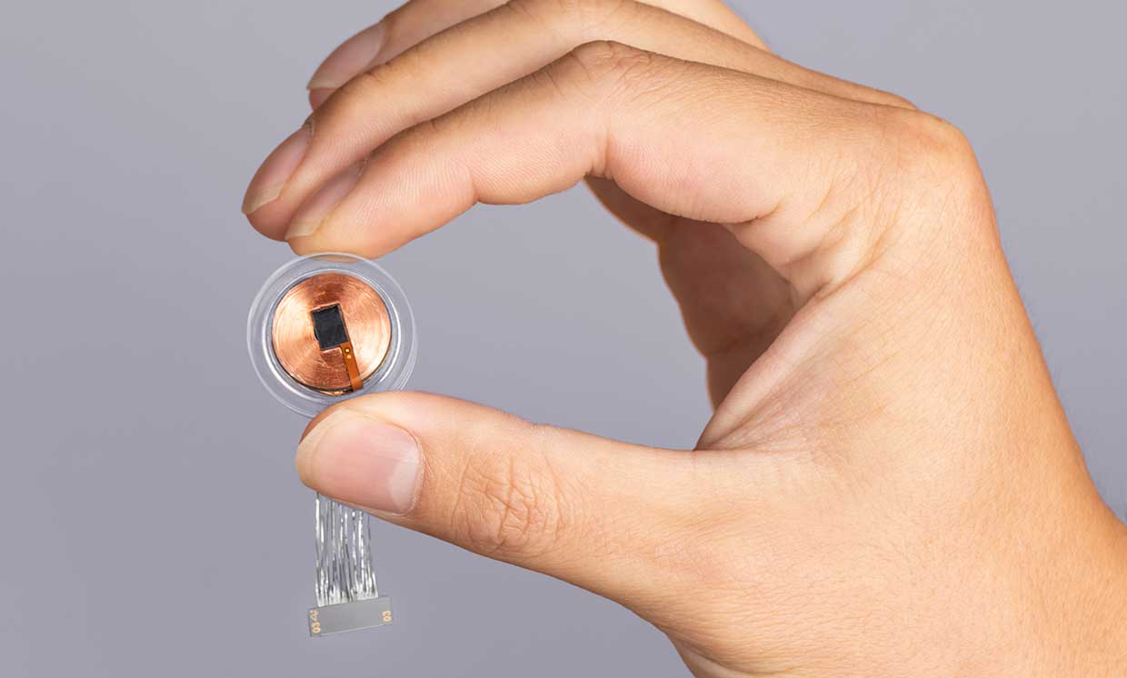
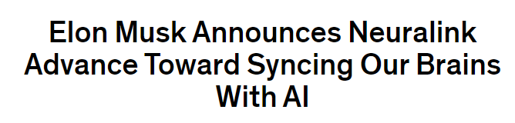
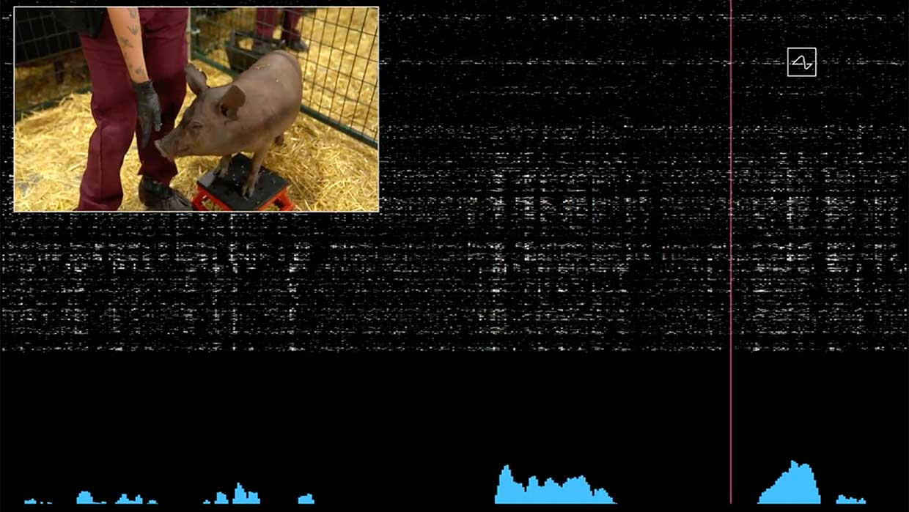
AI News – Day 16. Aug - 2020
Musk said that his company Neuralink had built a self-contained neural implant that can wirelessly transmit detailed brain activity without the aid of external hardware.
Musk demonstrated the device with live pigs, one of which had the implant in its brain. A screen above the pig streamed the electrical brain activity being registered by the device. “It’s like a Fitbit in your skull with tiny wires,” Musk said in his presentation. “You need an electrical thing to solve an electrical problem.”

Slide 11
Thanks!
Tomorrow session
Do you have any questions?
sanjay@pantechmail.com
www.pantechsolutions.net
Smart Attendance System

Slide 12
Day-16 Agenda.
01.
02.
03.
Label Reading & Methedology
OCR
Installing OCR
04.
05.
Reading Text from Image
Q & A
Overview on Label reading & Methods to deploy
Optical Character Recognition
Installing & Configuring Optical Character Recognition
Converting Text from Image

